Slide 1

Proteome Quantitation Methods Based on Chemical Labeling and Fragment Ions
The 7th China Workshop on Computational Proteomics (CNCP-2023)
Jianhui Liu
Dalian Institute of Chemical Physics
Chinese Academy of Sciences
August-31-2023

Slide 2
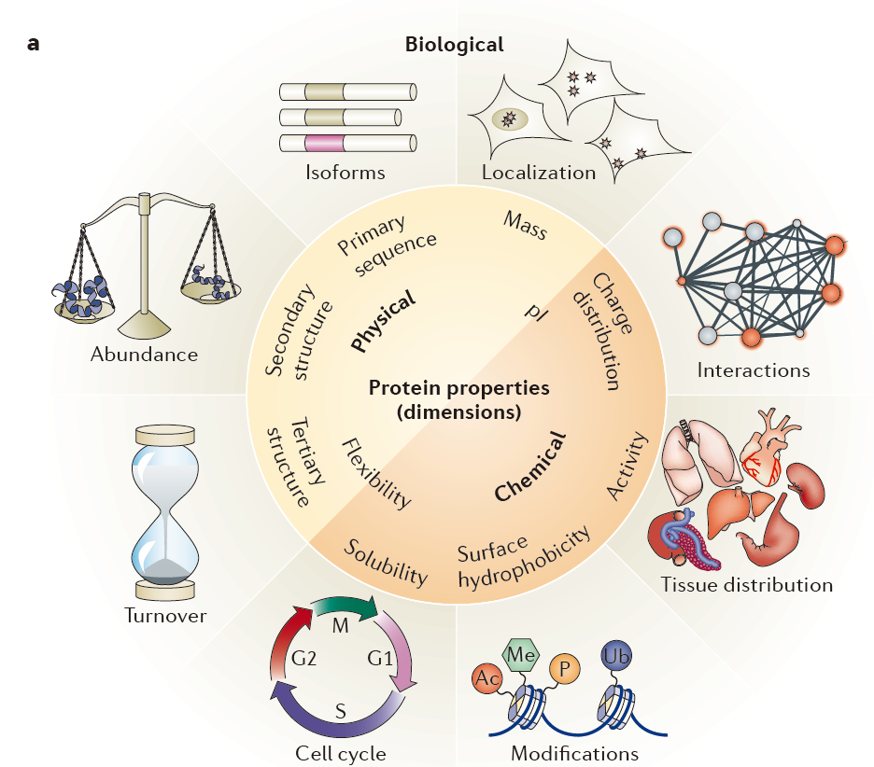
Quantitation Proteome
Proteome is a dynamic system during the biological progresses
Studying the dynamic behaviour of the proteins relies on accurate and robust quantitation methods
Borner, G. et al., Nat. Rev. Mol. Cell Biol., 2019, 20, 285; Mann, M. et al., Nat. Med., 2022, 28, 1277; Grundner, C. et al., Nat. Microbiol., 2023, 8, 548.

Slide 3
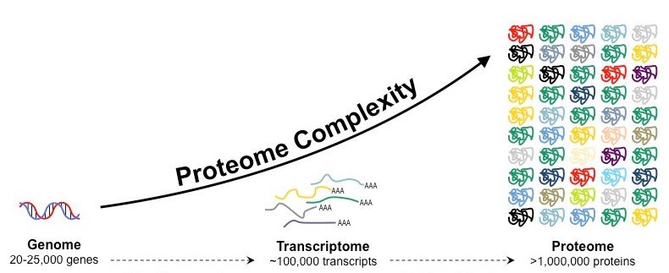
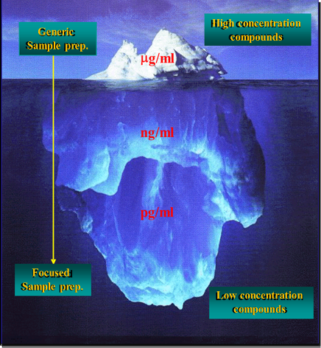
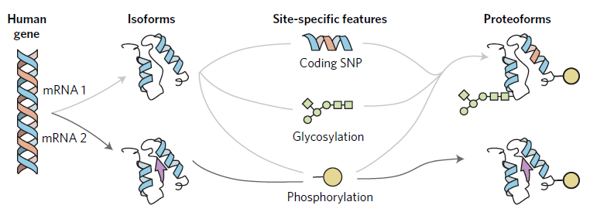
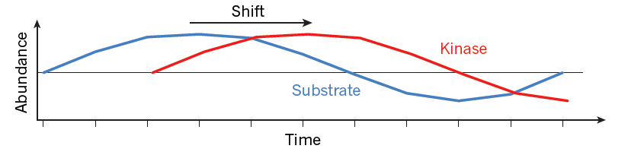
Challenges for Quantitation Proteome
Proteome Complexity（10⁶）
Wide Dynamic Range（ 12 orders of magnitude ）
Many Kinds of Proteoforms
In Dynamic Changes
Aebersold et al., Nat. Chem. Biol. 2018, 14, 206-214; Aebersold and Mann. Nature 2016, 537, 347-355.

Slide 4
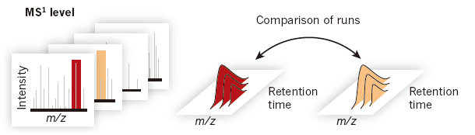
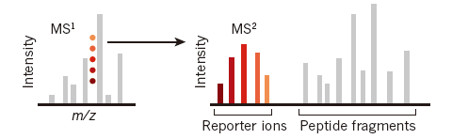
Strategies of Quantitative Proteome
Label free quantitation
Especially suitable for large sample cohorts
× High requirements for reproducibility and sensitivity of quantitative methods
Stable isotope labeling-based quantitation
Suitable for the in-depth analysis of biological processes
× Low quantitative accuracy of reporter ion-based methods
Aebersold, R. et al., Nature, 2016, 537, 347; Paulo, J. et al., Nat. Methods, 2020, 17, 399; Cox, J. et al., Nat. Biotech., 2021, 39, 1563.

Slide 5
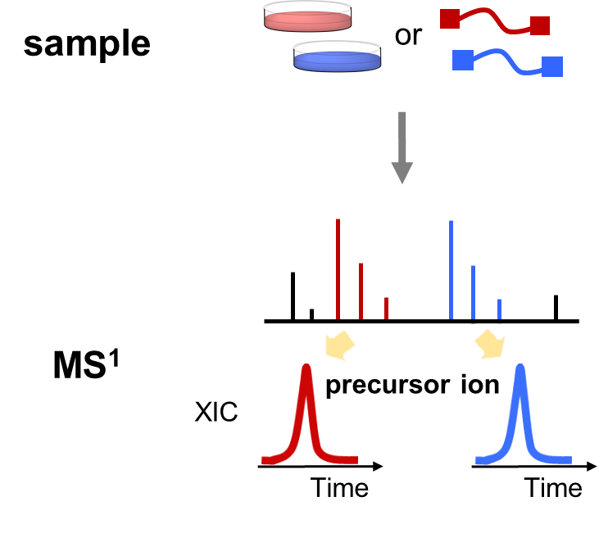
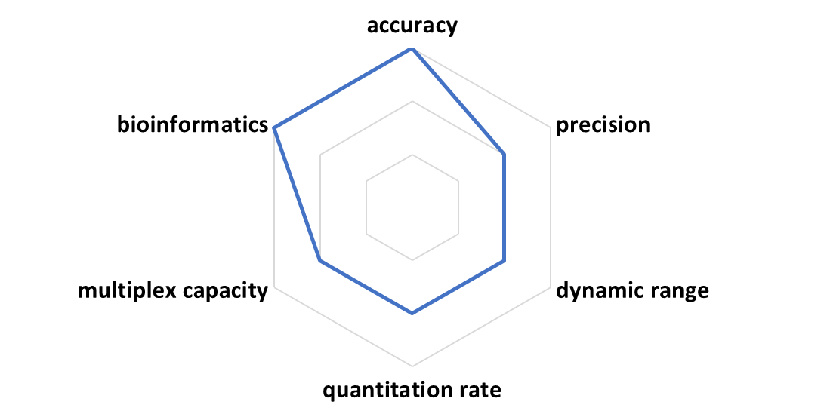
Precursor Ion-based Stable Isotope Labeling Methods
SILAC, dimethyl labeling
Ong, S.E.et al., Mol. Cell. Proteomics., 2002, 1, 376.

Slide 6
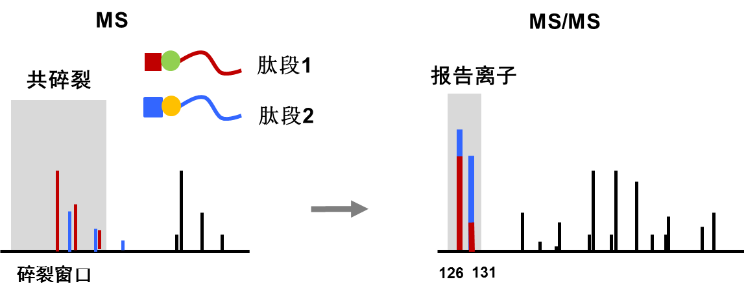
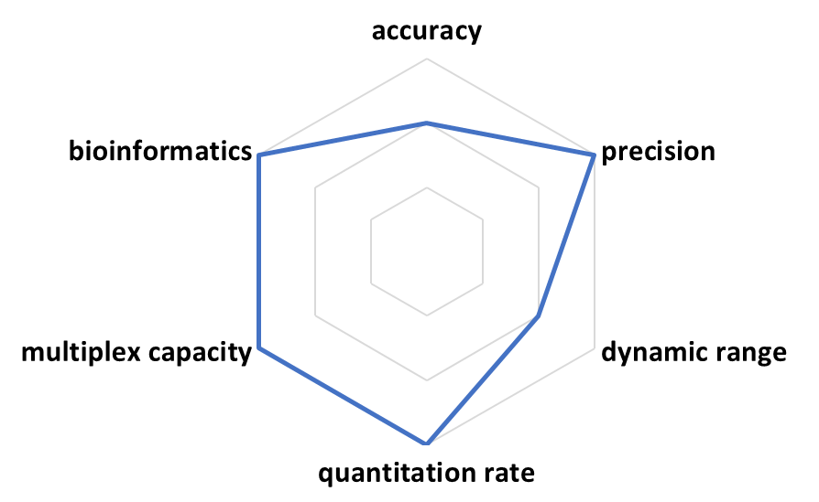
Reporter Ion-based Stable Isotope Labeling Methods
TMT, DiLeu
Interference of coisolated peptides usually exists in complex proteome quantitation and severely undermines the quantitation accuracy
Gygi, S. et al., Nat. Methods., 2020, 17, 399; Olsen, J. et al., Nat. Commun. 2018, 9, 1045; Tsybin, Y. et al., Anal. Chem., 2023, 95, 3712.

Slide 7
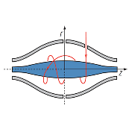
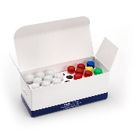
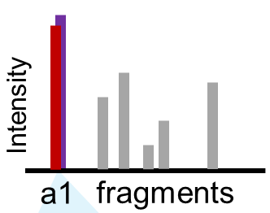

A Series of Proteomic Quantitation Methods Based on Fragment Ions
high accuracy and precision, high throughput, low cost
Labeling method
Pseudo-isobaric dimethyl and metabolic labeling
Quantitation ion
A1 ions
Multiplex kits
Acquisition method
Enlarged isolation window
Segmented MS/MS acquisition
A 6-plex kit by one-step dimethyl labeling
An 8-plex kit by isobaric dimethyl labeling

Slide 8
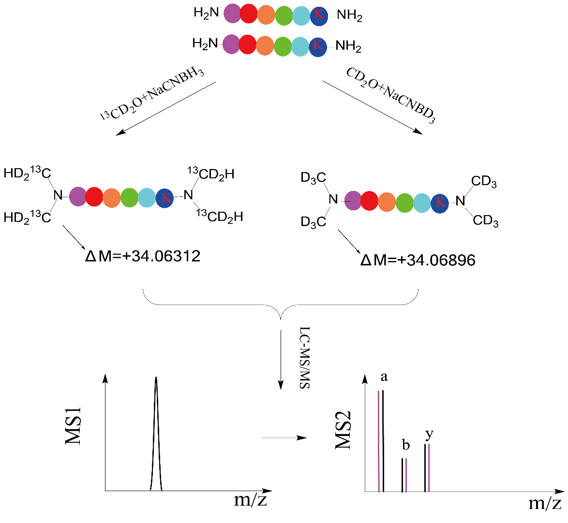
Pseudo-Isobaric Dimethyl Labeling (pIDL)
pIDL method with millidalton mass differences between channels of fragment ions
 | labeling reagents |  | mass increment/Da | Mass difference/mDa
pIDL | ¹³CD₂O | NaCNBH₃ | 34.06312 | 5.84 mDa
 | CD₂O | NaCNBD₃ | 34.06896
Precursor ion | CH₂O | NaBH₃CN | 28(.03130) | 4(.02511) Da
 | CD₂O | NaBH₃CN | 32(.05641)
LH. Zhang*, Anal. Chem., 2013, 85, 10658.

Slide 9
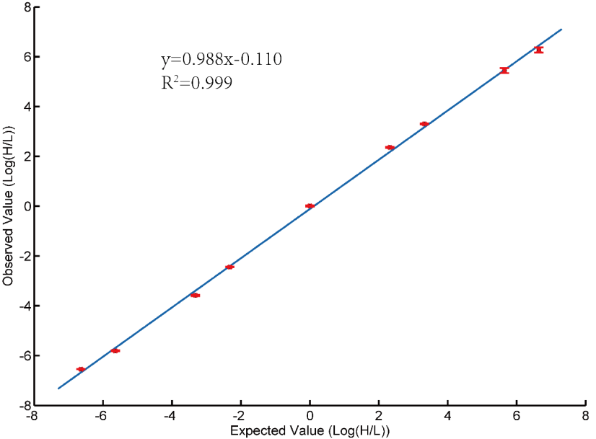
Dynamic Range
定量覆盖度
BSA: H/L=100:1, 50:1, 10:1, 5:1, 1:1, 1:5, 1:10, 1:50 and 1:100
 | pIDL | Precursor ion* Dimethyl labeling | Reporter ion* TMT
Dynamic Range | 4 Orders of Magnitude | 2 Orders of Magnitude
*Heck, A. J. et al, J Proteomics, 2013, 88, 14.

Slide 10
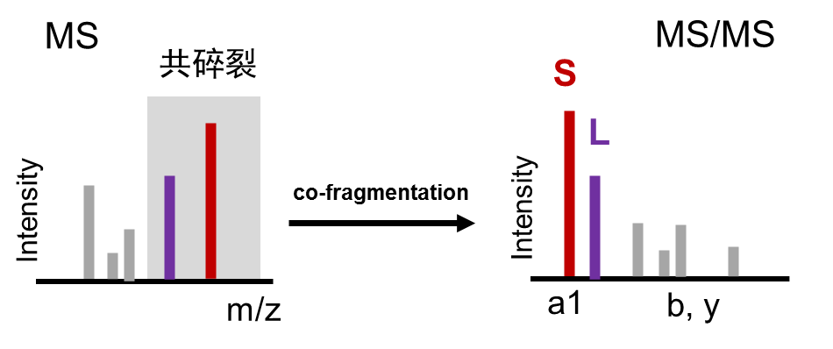
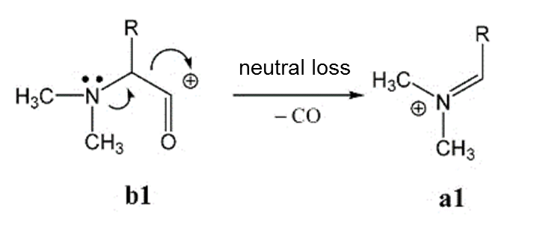
A1 Ion
high ion formation efficiency peptide specificity
enhanced ion intensity
SNFIDAIIK
肽段1
LLDTSIQMLR
肽段2
JH. Liu, LH. Zhang* et al., Anal. Chem., 2022, 94, 7637

Slide 11
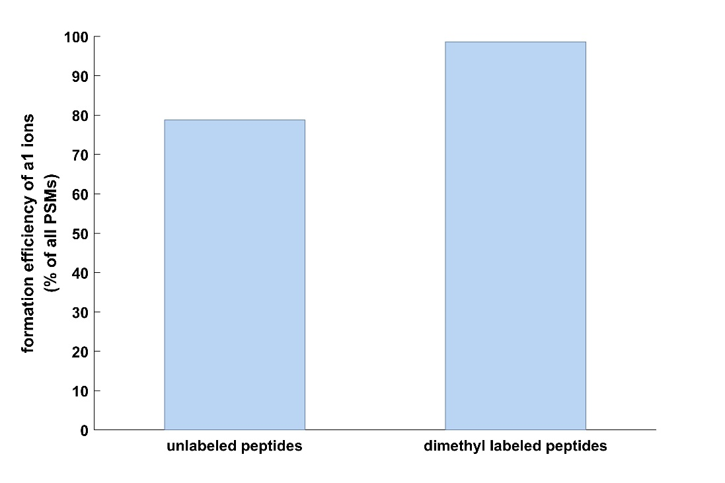
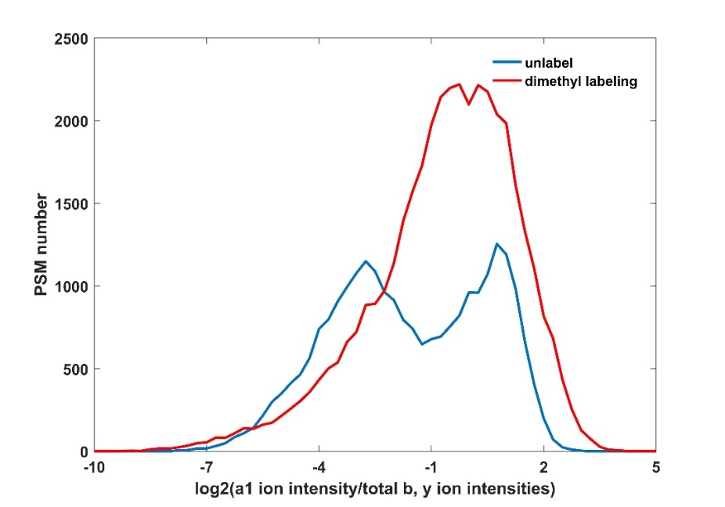
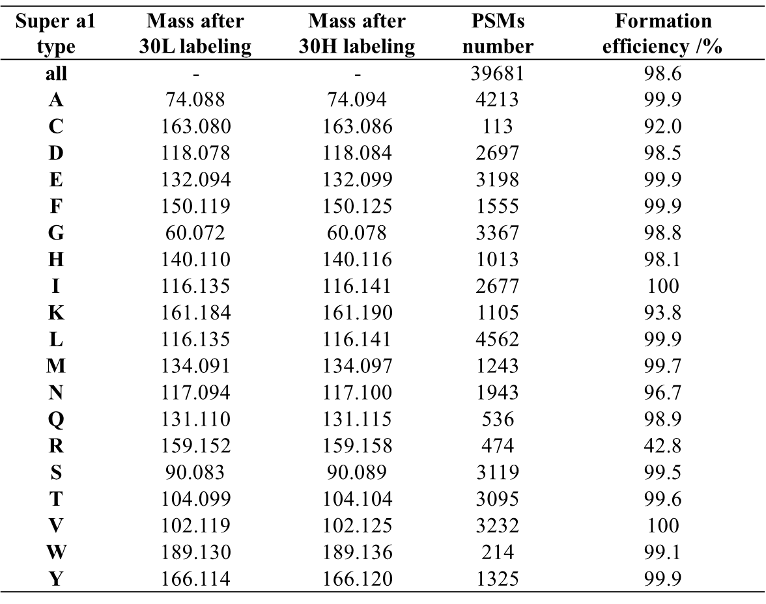
Ion Formation Efficiency and Intensity
high ion formation efficiency
99%
enhanced ion intensity
increased 2.34-fold
79%
The formation efficiencies of 15 types of amino acids were higher than 98%.

Slide 12
Quantitation Accuracy and Precision
 | a1 ion-based method |  |  |  | precursor ion-based method
 | H/L=1 | H/L=5 | H/L=10 | H/L=20 | H/L=1 | H/L=10
protein quantitation coverage | 99% | 98% | 96% | 88% | 75% | 67%
median | 0.97 | 5.26 | 10.65 | 18.90 | 1.01 | 6.94
SD (log2) | 0.16 | 0.18 | 0.22 | 0.22 | 0.14 | 0.64
median CV | 5% | 6% | 8% | 11% | 6% | 19%

Slide 13
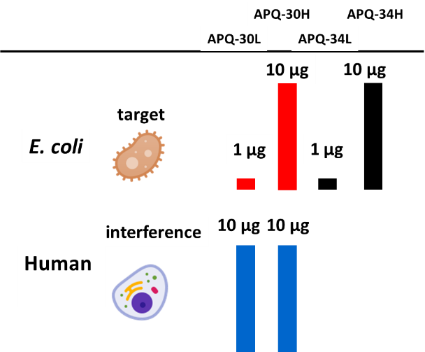
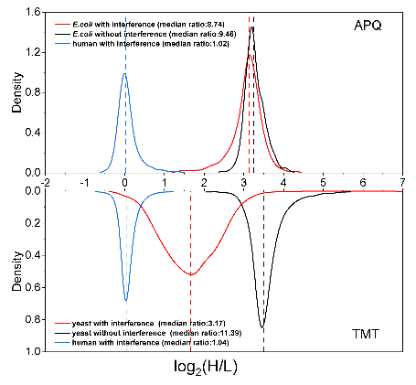
Overcome Ratio Distortion
Relative error 8%
Relative error 72%
Gygi, S. P., et al., Nat. Methods, 2011, 8, 937.

Slide 14
Quantify Co-fragmented Peptides Simultaneously

Slide 15
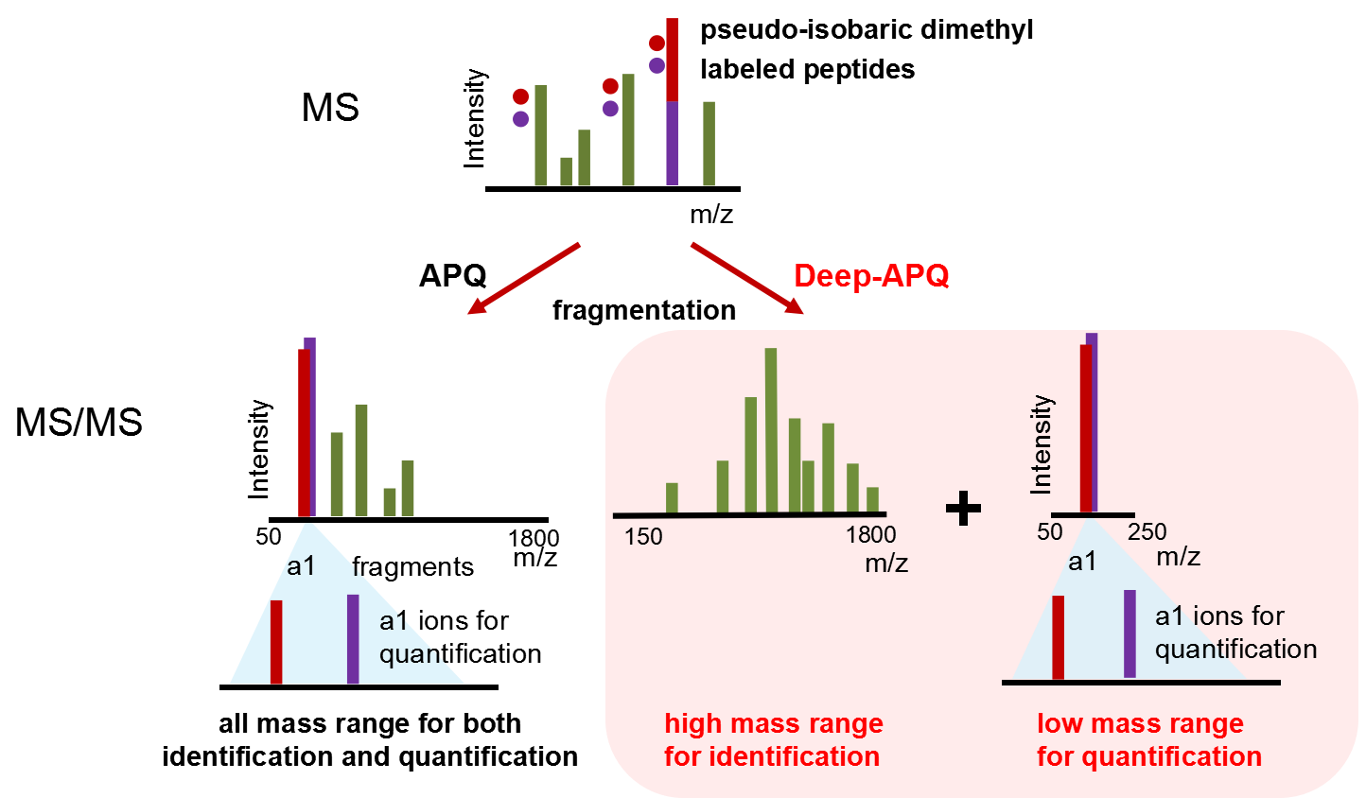
A Deep-coverage A1 Ion-based Quantitation Method
Deep-APQ: Segmented MS/MS acquisition of a1 ion-based strategy for in-depth proteome quantitation
JH. Liu*, LH. Zhang* et al., Anal. Chim. Acta, 2022, 1232, 340491.

Slide 16
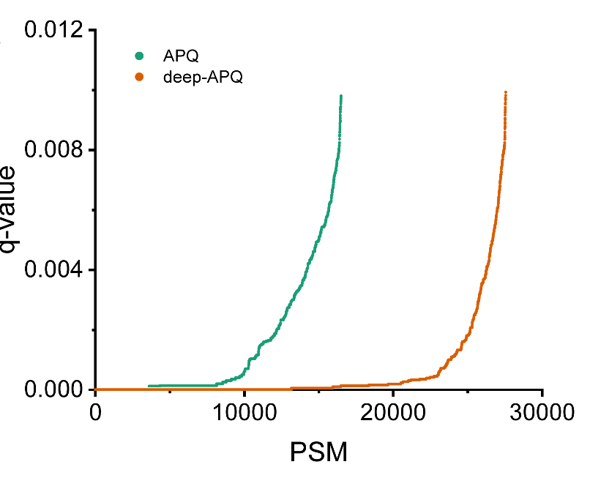


Evaluation of Quantitation Depth
More acquired spectrum had higher
identification confidence
More fragment ions were shown,
especially in the high mass range
APQ
Deep-APQ
16

Slide 17
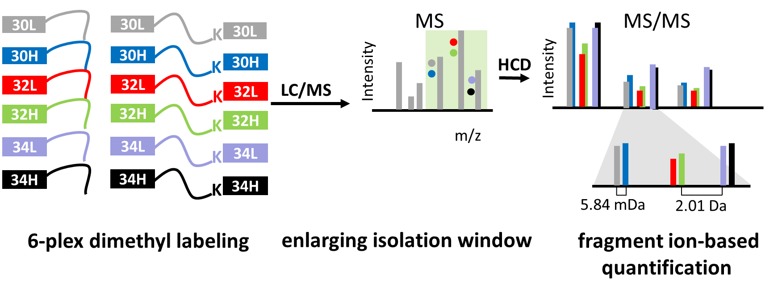
A 6-plex pIDL Method (m-pIDL)
Extend the capacity of the fragment-ion-based method to 6-plex by one-step dimethyl labeling
JH. Liu, LH. Zhang* et al., Anal. Chem., 2019, 91, 3921.

Slide 18
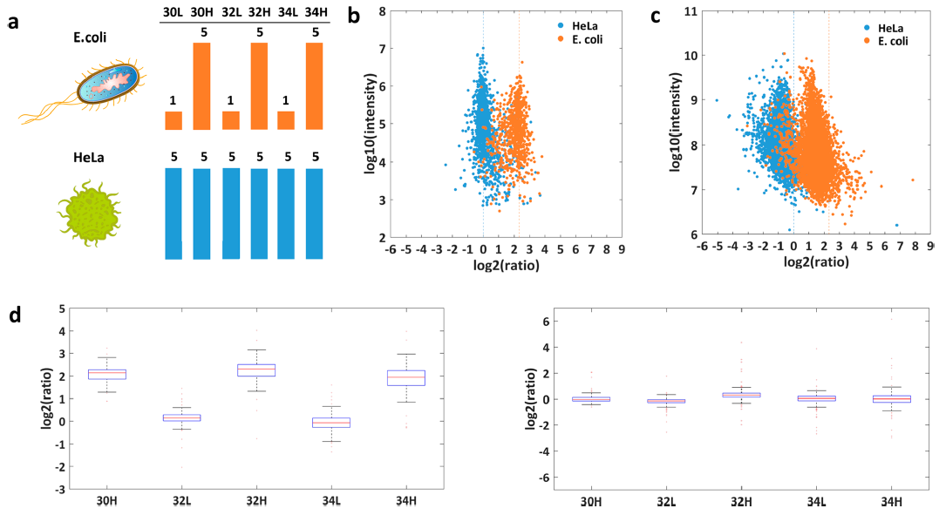
Quantitative Analysis in a Two-Proteome Model of Interference
m-pIDL
LFQ
E.coli digests
HeLa digests

Slide 19
Suitable for PTM quantitation
pIDL shows the compatibility among diversely modified peptides
 | 32L | 32H | 34H
O-phosphopeptide | 1.02 | 5.77 | 3.48
N-phosphopeptide | 0.93 | 5.74 | 3.56
O-glycopeptide | 0.87 | 6.59 | 3.63
Unmodified peptide | 0.92 | 5.08 | 3.42
Median CV: 6.66%

Slide 20
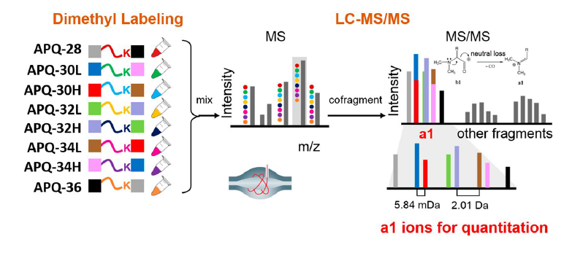
A 8-plex a1 Ion-based Method
Develop an 8-plex isobaric labeling strategy by designing different isotopes of dimethyl labeling reagents to selectively react with the N-terminals and lysines of Lys-C digests
JH. Liu, LH. Zhang* et al., Anal. Chem., 2022, 94, 7637 JH. Liu, LH. Zhang* et al., Chinese J. Chromatography, 2018, 36,230

Slide 21
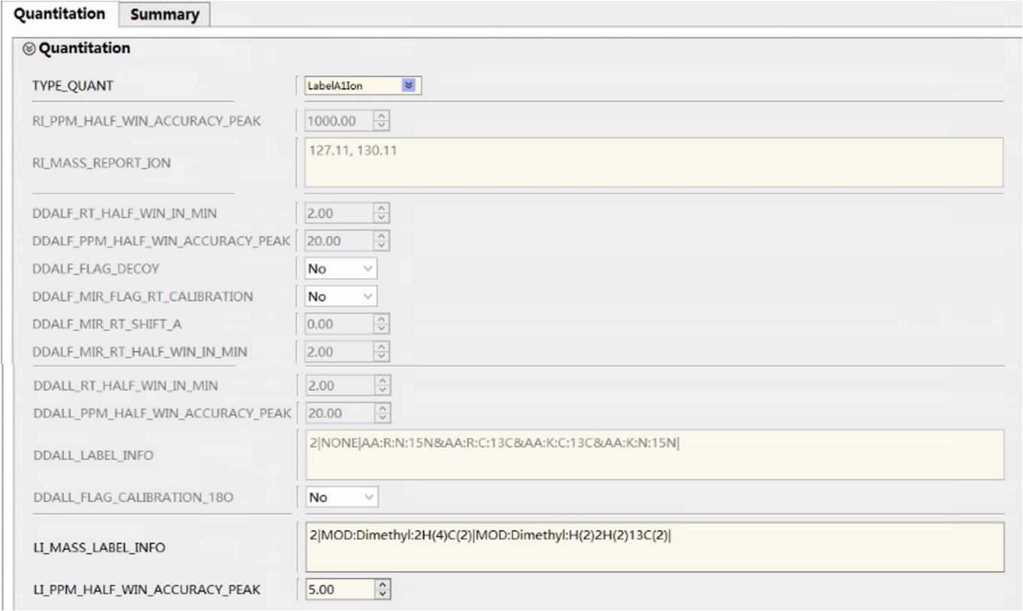
Quantified by pQuant

Slide 22
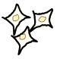
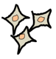
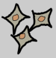
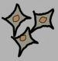
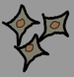
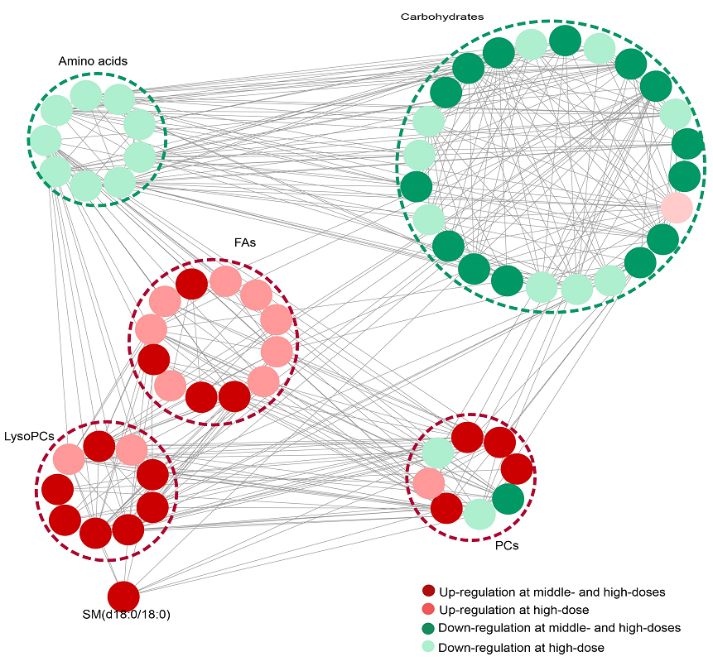
Analyzing the Protein Expression Changes By PM_{2.5} Exposure
control
10 μg/mL
50 μg/mL
100 μg/mL
250 μg/mL
well related
Proteome data
Metabolome data
JH. Liu, LH. Zhang* et al., J. Haz. Mat., 2022, 424, 127573.

Slide 23
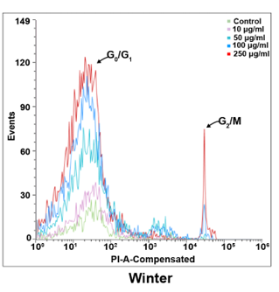
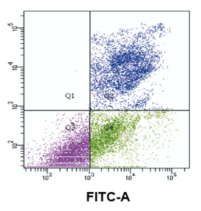
Biological processes regulated by differentially expressed proteins
Notes:
差异蛋白调控的生物学过程分析表明，发现除了影响rRNA加工等过程外，PM2.5会调控细胞周期和凋亡。细胞毒理学实验证实，细胞在G0/G1期和G2/M期发生了阻滞，并且凋亡现象显著，与蛋白质组学数据结果相符

Slide 24
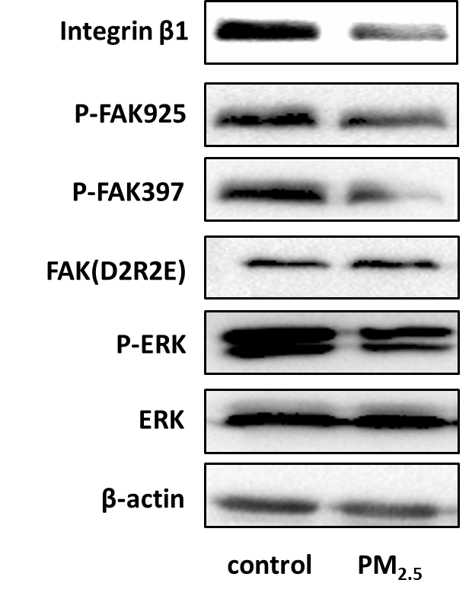
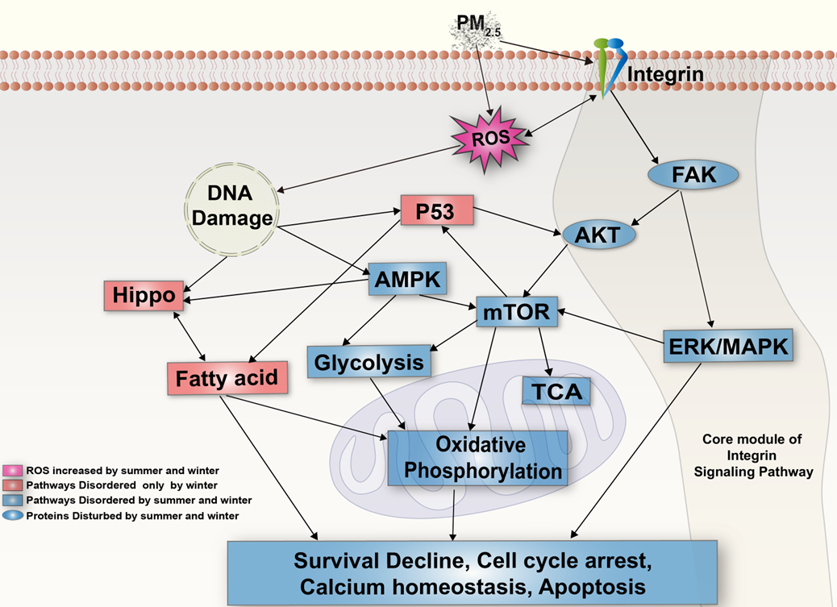
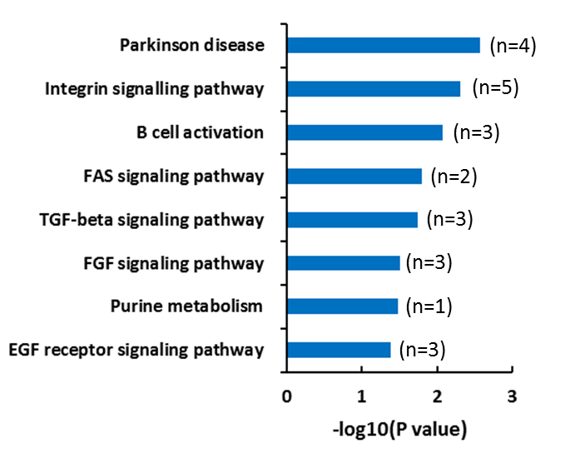
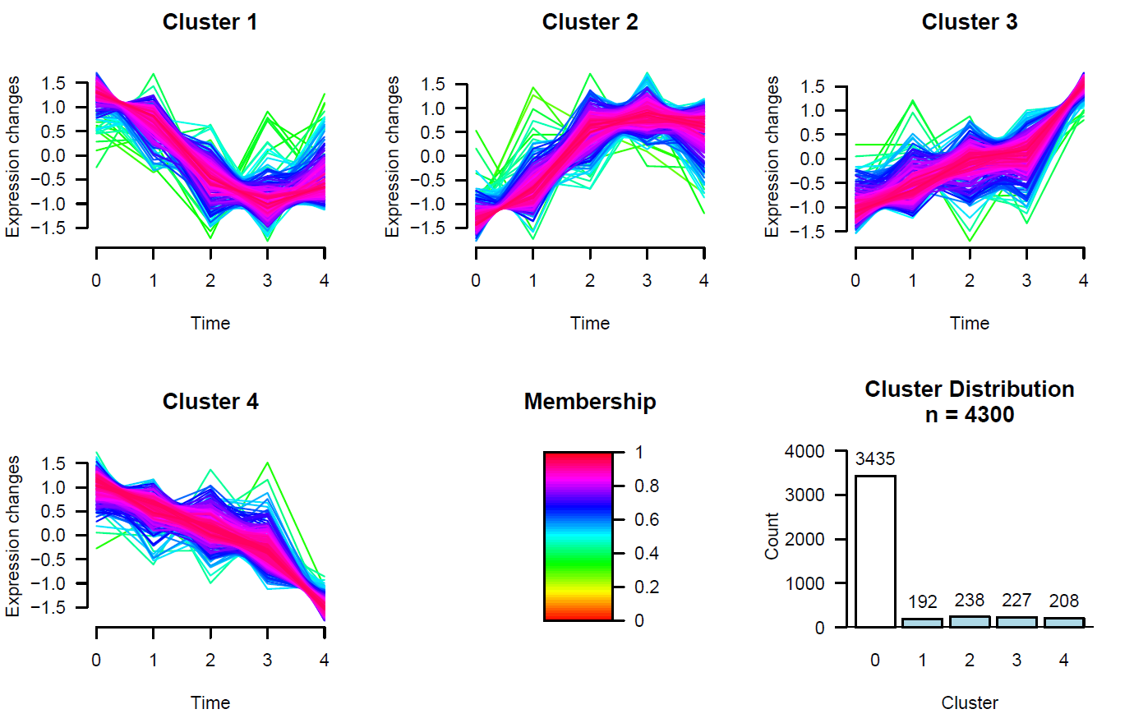
Integrin signaling pathway plays a regulatory role in the perturbation of PM_{2.5}
concentratio
Integrin β1: down-regulated 1.6-fold
Notes:
PM2.5暴露后细胞内ROS增加，引起氧化应激和DNA损伤。氧化应激引发整合素途径的抑制和糖、脂代谢、mTOR、AMPK、p53等通路紊乱，进而造成细胞周期阻滞，出现凋亡

Slide 25
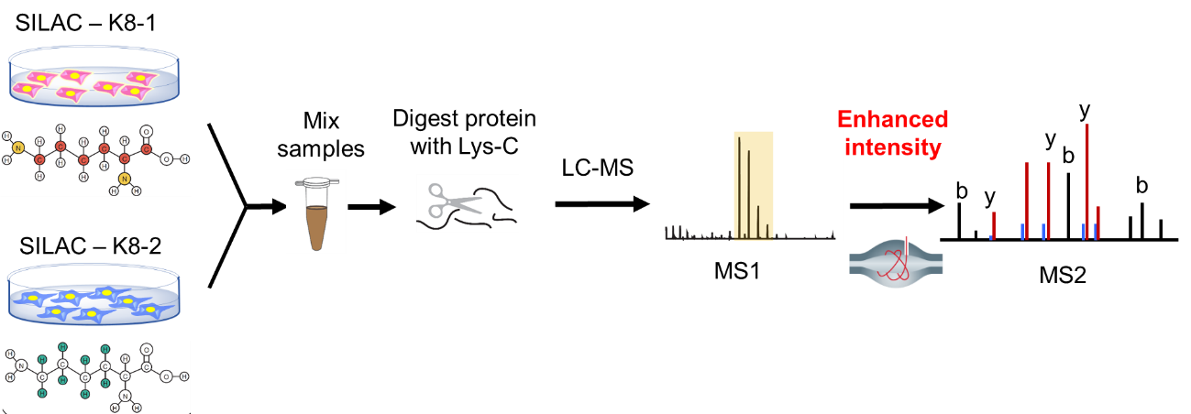
Fragment Ion-based SILAC Method (E-pSILAC)
Fragment ions show potential to improve the quantitation performance of metabolic labeling
Using resolved y ion pairs as quantitation ions
Increased intensity threshold (AGC, IT) of tandem mass spectra
Enhanced pseudo-isobaric SILAC
Unpublished data

Slide 26
Quantitation Accuracy and Precision
 | 1:1 |  | 10:1 |  | 20:1
 | E-pSILAC | SILAC | E-pSILAC | SILAC | E-pSILAC | SILAC
quantitation coverage /% | 100 | 60 | 99 | 32 | 97 | 25
median | 0.93 | 1.03 | 9.03 | 6.64 | 18.44 | 9.62
SD (log2) | 0.16 | 0.56 | 0.27 | 1.11 | 0.35 | 1.56
CV /% | 5.11 | 7.77 | 8.63 | 10.08 | 10.01 | 13.84
E-
E-
E-
Unpublished data

Slide 27
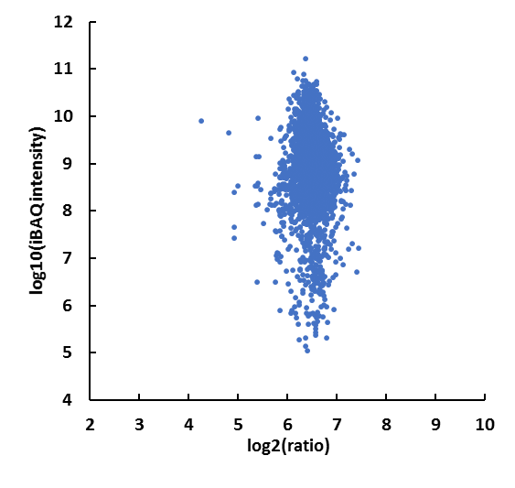
100-fold Dynamic Range
Quantitation coverage: 89%
Relative error: 7.87%
Median of CV: 10.24%
Accurate quantitation ratios without the influence of protein abundance
Unpublished data

Slide 28
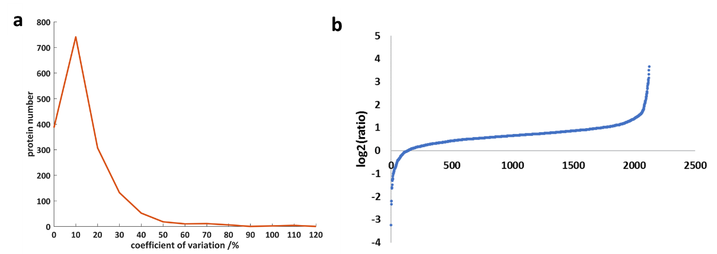
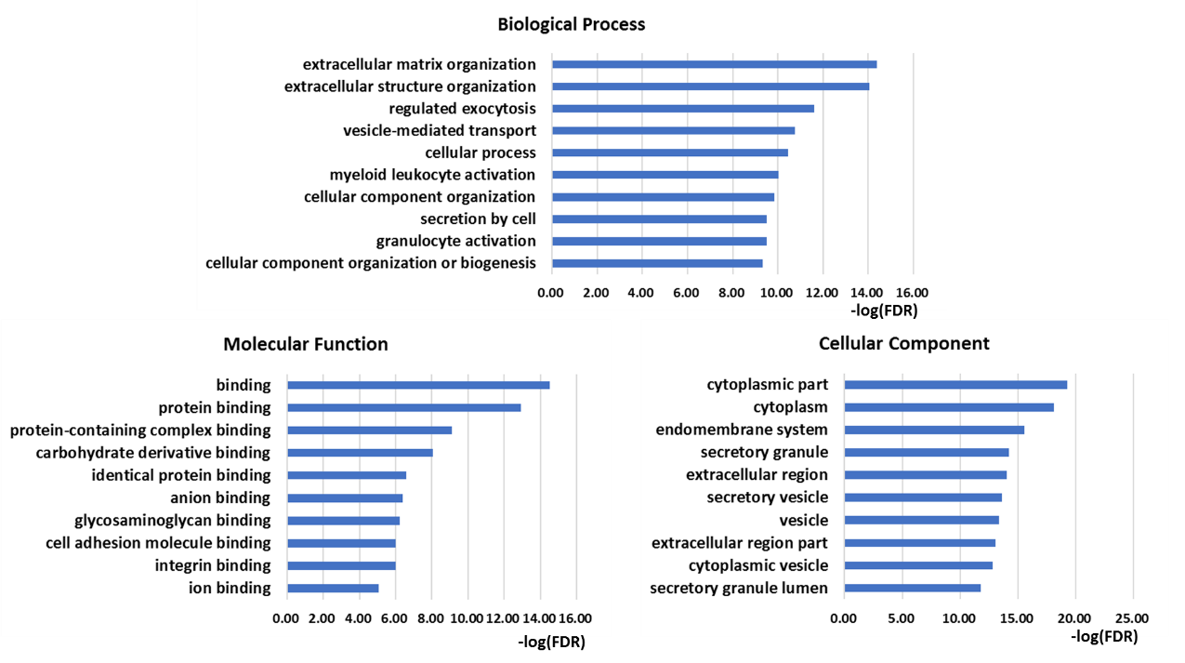
Quantitation of Exosomal Proteins During EMT
E-pSILAC facilitates the quantitation of exosome proteins with significant fold changes
Up-regulation of major proteins with median of 1.60
Gene name | Ratio of exosomal protein | Ratio of intracellular protein
SERPINE1 | 11.34 | 8.10
IGFBP7 | 8.15 | 3.54
Exosomal protein changes are larger than intracellular proteins
Unpublished data

Slide 29
Conclusion
Quantitation ion |  | Precursor ion | Reporter ion | Fragment ion（our method）
Methods |  | SILAC/dimethyl labeling | TMT / iTRAQ | Chemical Labeling | Metabolic labeling
Accuracy | Relative error | <20% | <12% | <10% | <10%
 | Ratio distortion | — | >2.2 fold | 1.1 fold | —
Dynamic Range |  | <10 fold | 20 fold | 20 fold | 100 fold
Multiplex capacity |  | 3-plex | 18-plex | 8-plex | 2-plex
Coverage |  | <80% | >90% | >90% | >90%

Slide 30
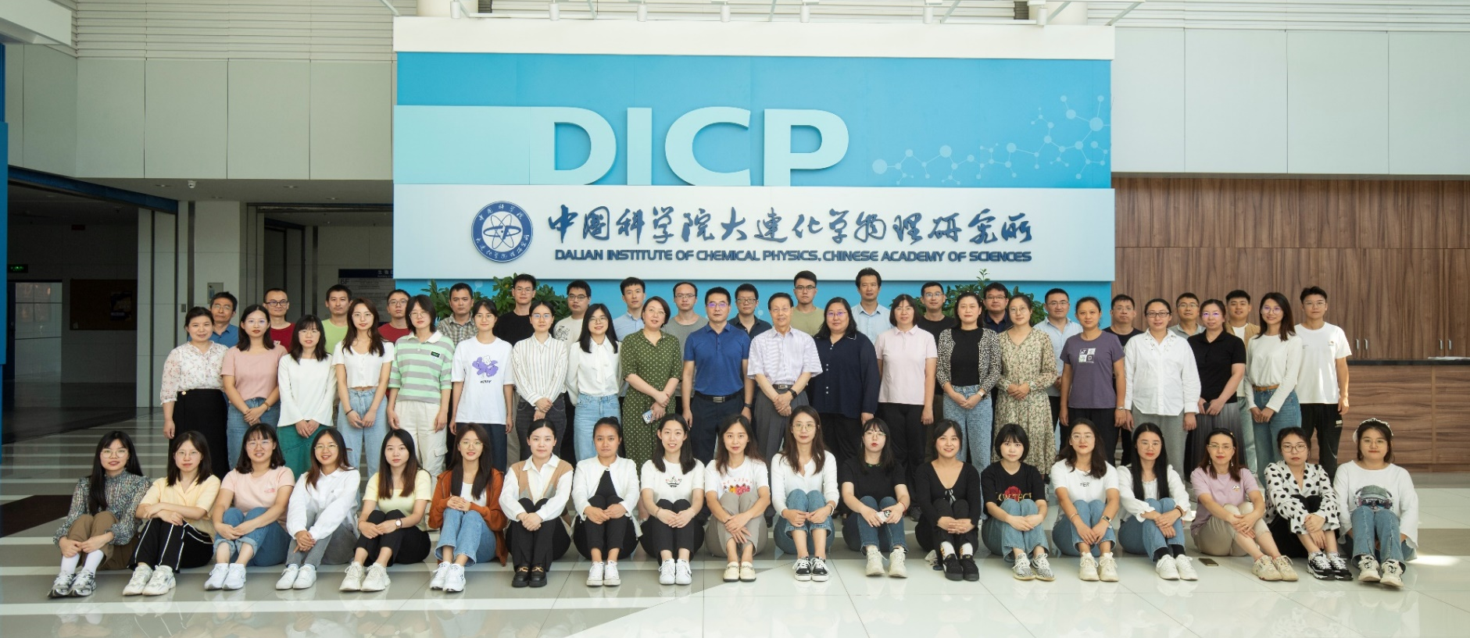

Acknowledgements
National Natural Science Foundation of China
Ministry of Science and Technology of the People’s Republic of China
Dalian Institute of Chemical Physics
Yuan Zhou, Zhiting Wang
Chao Liu, Xinhang Hou, Pengyun Gong
Jiping Chen, Xiaoyao Song
Thank you for your attention!

